Slide 1

Verification and Validation of Safety and Security Requirements In Autonomous Vehicle
ECE 5734- Embedded System Verification & Validation
Project Progress
Presented By
Cory Ness
Kokila Subramanian
Under the Guidance of
Professor Ramesh Sethu

Slide 2
Objective
To develop an autonomous Vehicle model based on physics that simulate sensors for velocity & distance measurement, lane centring for cruise control using LabVIEW simulation tool.
To identify, verify and validate the functional requirements of the Autonomous vehicle model with respect to safety and security metrics defined reliant on SAE Automation Levels.
Safety requirement analysis is made based on hazard analysis, lane control, automatic braking system, steering rotation, stability of vehicle and accidental failures.
Security requirements are analysed based on the threat and risk assessments

Slide 3
Safety Requirements
Dynamic Driving Conditions
Increase and decrease the speed of the vehicle based on the driving and traffic conditions
Ensure Controllability of Vehicle
Determine the Good Acceleration and Turn thresholds that maintains stability of the vehicle
Collision Free and Law Full driving plan
Identify obstacles in path and perceive the position of surrounding objects
Execute and Actuate right driving plan
Combine the driving plan and Egomotion to control motion actuators
Dynamic Lane Merge System
Perform lateral control to maintain lane and execute seamless lane change

Slide 4
Test Cases for Verification of Safety Requirements
1. Drive straight ahead at 60MPH
2. Speed Up and Speed down
3. Stability of vehicle at 360° turn
4. Unsafe Real-Time Driving case
5. Obstacle Detection
6. Lane control & Seamless Lane Merge
7. Reverse Parking in lane

Slide 5
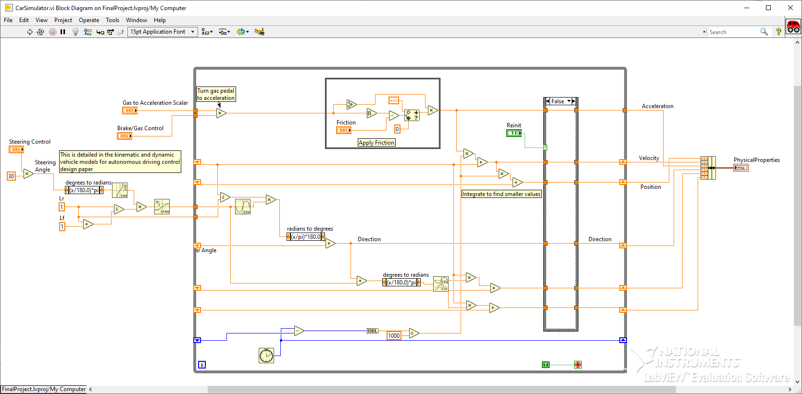
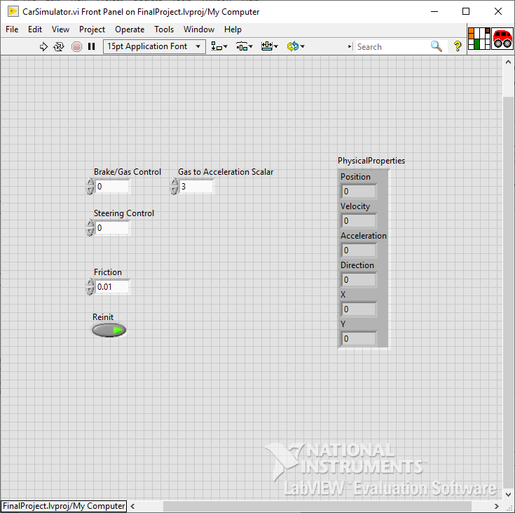
Model Based Autonomous Vehicle Control Design Car Simulation Model – Block Diagram
Physics-oriented, using stacked integration to calculate the position, velocity, and acceleration from an input force.
Based on the equations present in “Kinematic and Dynamic Vehicle Models for Autonomous Driving Control Design”
Provides physical variables of the autonomous vehicle as a result of the inputs over time.

Slide 6
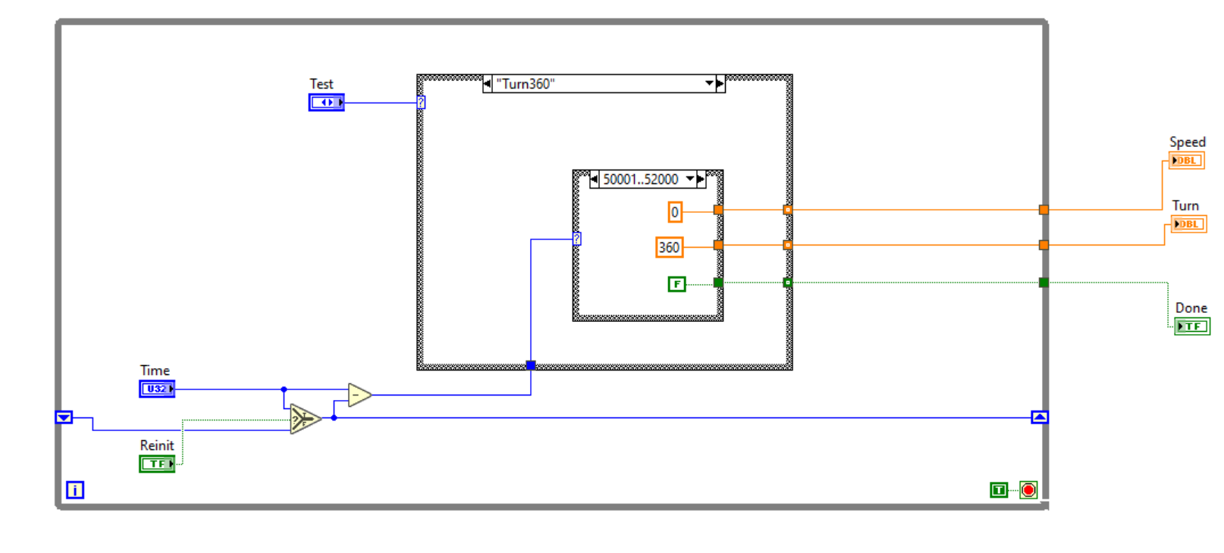
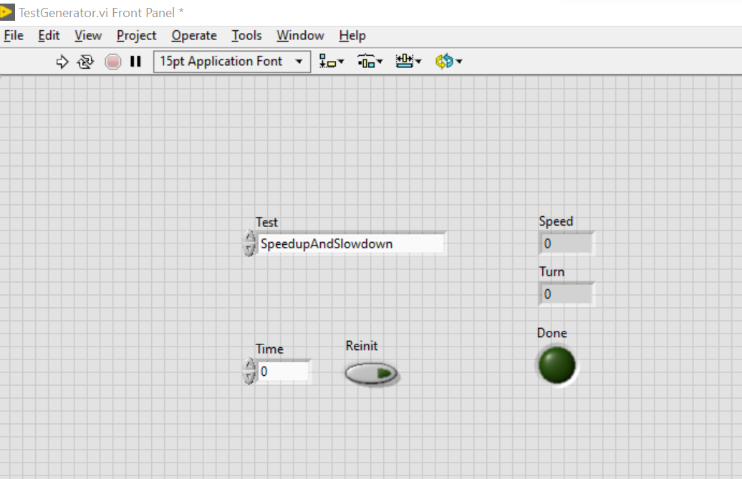
Test Generator
Generates the targets for the model to represent and the requirements to verify against.
Specify the test to run among many tests.

Slide 7
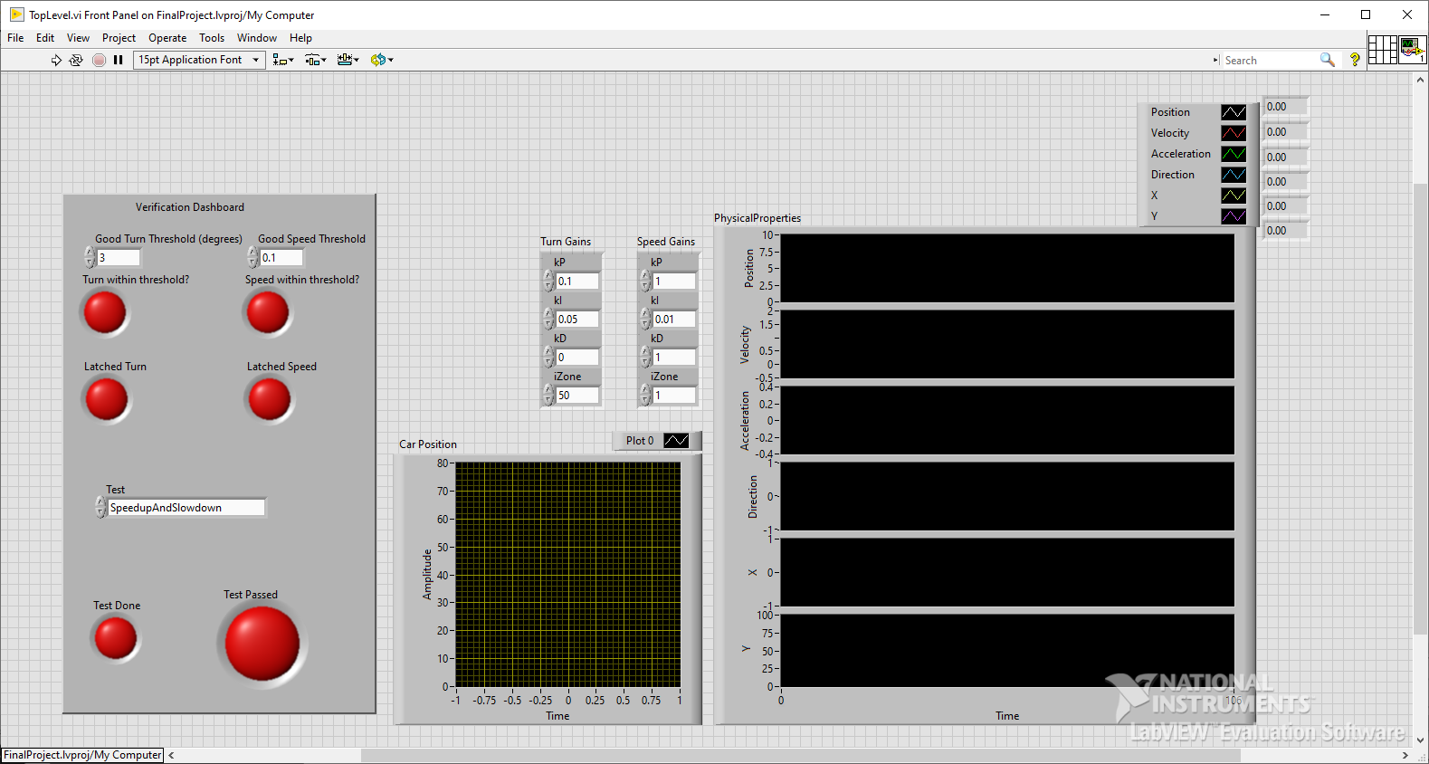
Top Level- Verification Dashboard
Specify what test to run with what thresholds for a successful test.
Debug information based on the model, such as 2D position & model states (position, velocity, acceleration).
Verification dashboard to show results of the test.

Slide 8
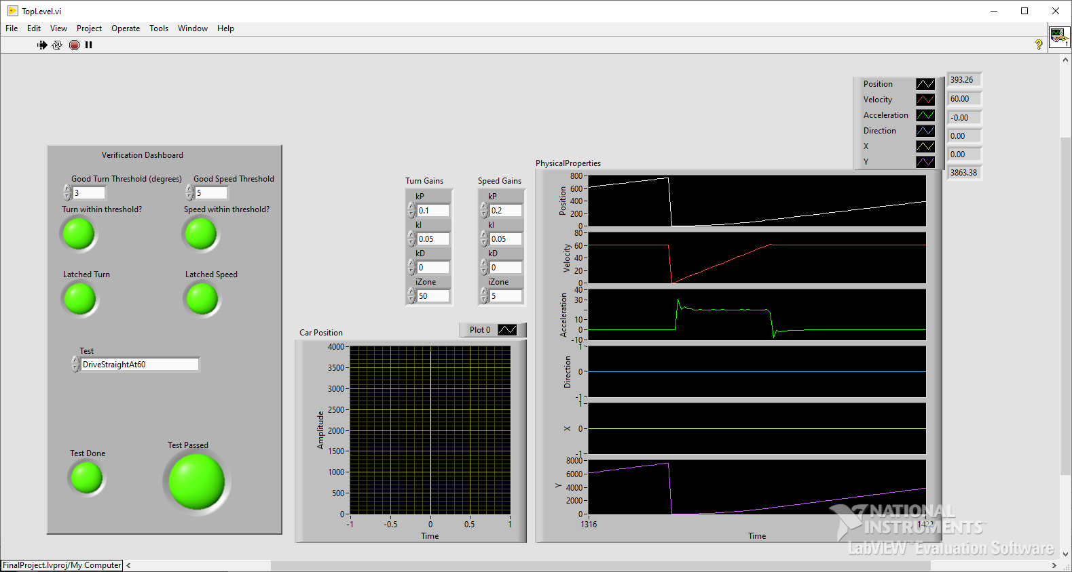
Drive Straight Ahead at 60 MPH
Models entering highway from on-ramp.
Ensures vehicle accelerates at an acceptable rate.
Ensures the vehicle can maintain a speed.
Ensures vehicle can drive straight.

Slide 9
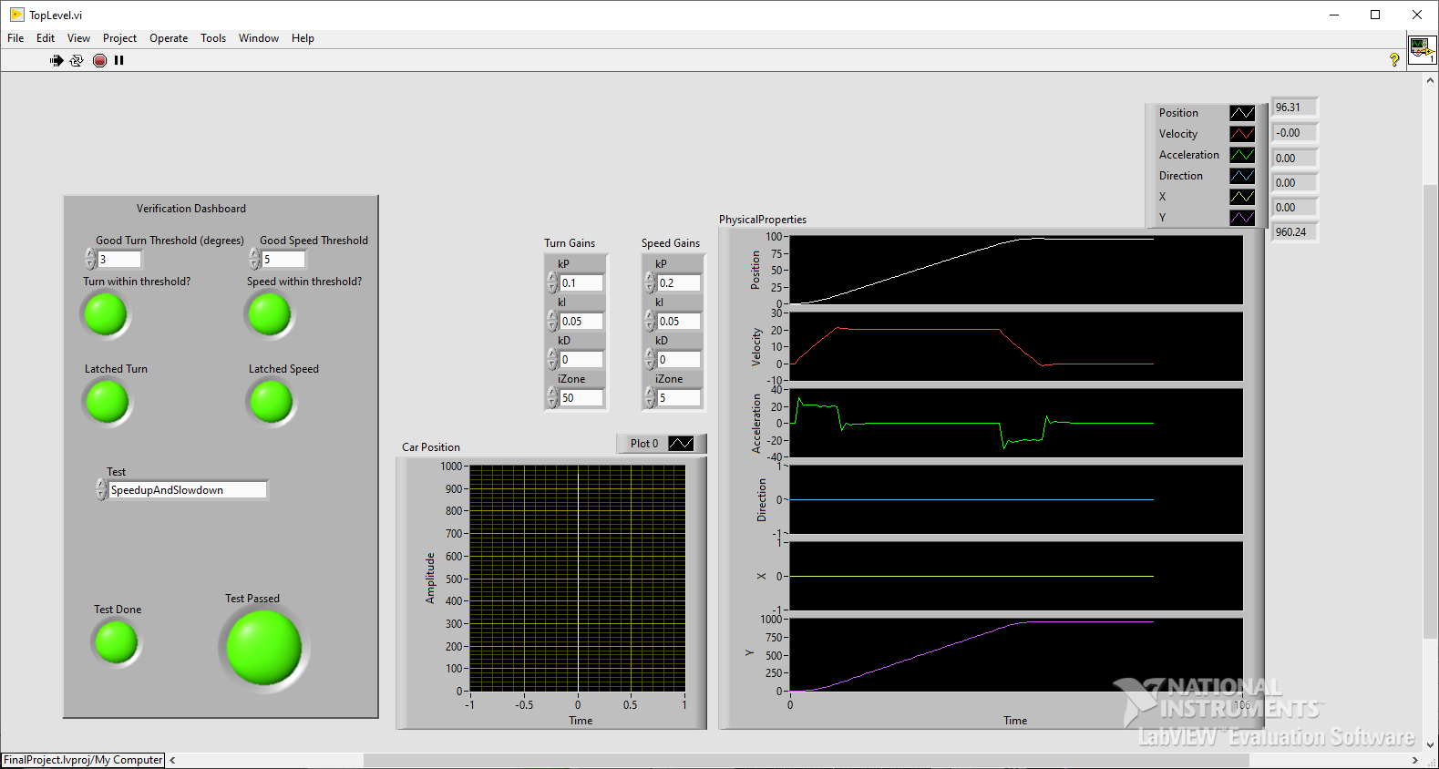
Speed up and Speed Down Test
Tests accelerating to 20 mph then slowing down to a stop.
Makes sure both acceleration and deceleration are within reason.
Also makes sure driving straight works as intended.

Slide 10
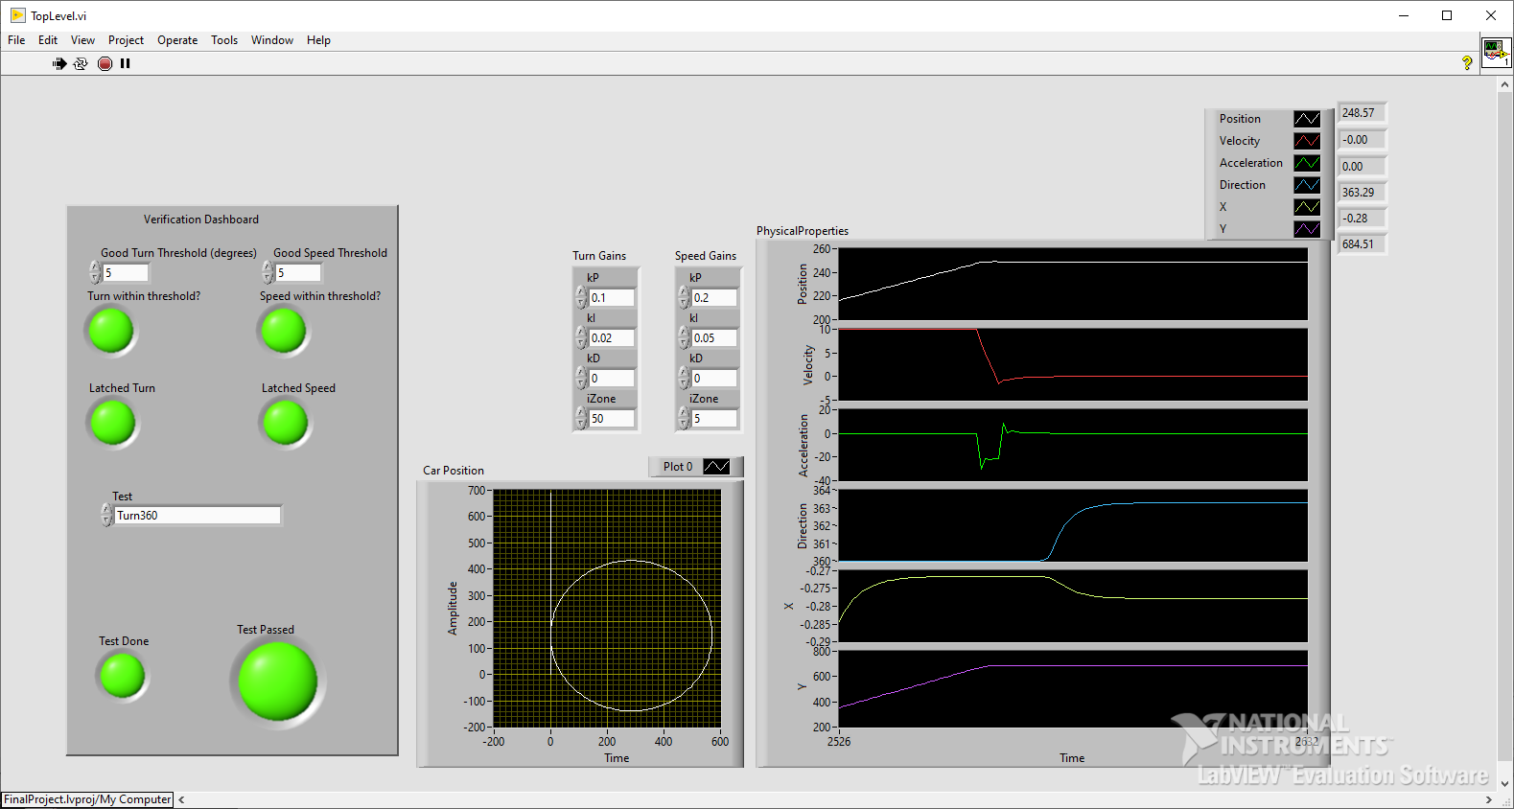
Turn 360° Test
Tests to make sure the car can turn without issue.
Checks against heading to ensure car is pointed in the correct direction throughout the turn.

Slide 11
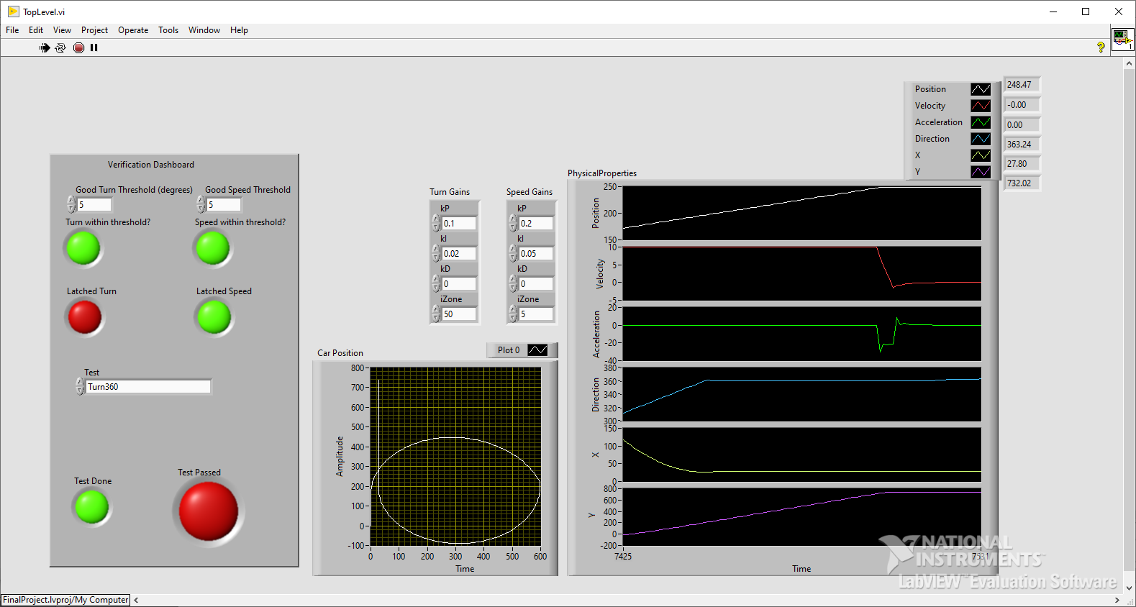
Example of a failed test
This is an example of a failed 360 test.
The car couldn’t follow through the expected turn all the way through
This led to a lopsided 360, failing the test.

Slide 12
List of tests
Test Case | Description | Currently Complete?
Drive straight ahead at 60 MPH | Accelerate to 60mph and drive straight | Yes
Speed Up and Speed Down | Accelerate to 20mph, then decelerate to 0mph | Yes
Turn 360° | Turn 360 degrees at 10mph | Yes
Obstacle Avoidance | Drive straight at 45mph, then perform a swerve to avoid obstacle in front of car | No
Lane Change | Drive straight at 60mph, then perform a lance change motion to shift lateral position | No
Back-in Parking | Drive straight at 10mph, then reverse and turn into a parking spot 90 degrees from orientation. | No

Slide 13
References
Ailon, A., Berman, N., & Arogeti, S. (2005). On controllability and trajectory tracking of a kinematic vehicle model. Automatica, 41(5), 889–896. https://doi.org/10.1016/j.automatica.2004.11.025
Benz: Safety First for automated driving. Mercedes. (2019, July 4). https://www.mercedes-benz.com/en/innovation/safety-first-for-automated-driving/?csref=sm_fbk_gims2019_pc.html
Kang, C. M., Lee, S.-H., & Chung, C. C. (2018). Multirate Lane-keeping system with kinematic vehicle model. IEEE Transactions on Vehicular Technology, 67(10), 9211–9222. https://doi.org/10.1109/tvt.2018.2864329
Kong, G., Pfeiffer, Mark., Schildbach, G., and Borrelli, F. Kinematic and dynamic vehicle models for Autonomous Driving Control Design. IEEE Xplore. (n.d.). https://ieeexplore.ieee.org/document/7225830
Sabaliauskaite, G., Liew, L., & Cui, J. (1970, January 1). [PDF] Integrating Autonomous Vehicle Safety and security analysis using STPA method and the six-step model: Semantic scholar. undefined. https://www.semanticscholar.org/paper/Integrating-Autonomous-Vehicle-Safety-and-Security-Sabaliauskaite-Liew/dcc9ab963f2f4d97b5dc81d0e8df0708008d36a8

